Slide 1
CCS3104
ADVANCED PROGRAMMING Chapter 2 Event-Driven Programming

Slide 2
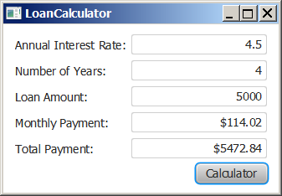
Motivations
Suppose you want to write a GUI program that lets the user enter a loan amount, annual interest rate, and number of years and click the Compute Payment button to obtain the monthly payment and total payment. How do you accomplish the task? You have to use event-driven programming to write the code to respond to the button-clicking event.
LoanCalculator
Run

Slide 3
Objectives
To get a taste of event-driven programming (§15.1).
To describe events, event sources, and event classes (§15.2).
To define handler classes, register handler objects with the source object, and write the code to handle events (§15.3).
To define handler classes using inner classes (§15.4).
To define handler classes using anonymous inner classes (§15.5).
To simplify event handling using lambda expressions (§15.6).
To develop a GUI application for a loan calculator (§15.7).
To write programs to deal with MouseEvents (§15.8).
To write programs to deal with KeyEvents (§15.9).

Slide 4
Procedural vs. Event-Driven Programming
Procedural programming is executed in procedural order.
In event-driven programming, code is executed upon activation of events.

Slide 5
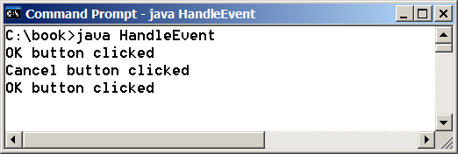
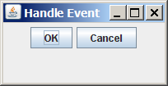
Taste of Event-Driven Programming
The example displays a button in the frame. A message is displayed on the console when a button is clicked.
HandleEvent
Run

Slide 6
import javafx.application.Application;
import javafx.geometry.Pos;
import javafx.scene.Scene;
import javafx.scene.control.Button;
import javafx.scene.layout.HBox;
import javafx.stage.Stage;
import javafx.event.ActionEvent;
import javafx.event.EventHandler;
public class HandleEvent extends Application {
@Override // Override the start method in the Application class
public void start(Stage primaryStage) {
// Create a pane and set its properties
HBox pane = new HBox(10);
pane.setAlignment(Pos.CENTER);
Button btOK = new Button("OK");
Button btCancel = new Button("Cancel");
OKHandlerClass handler1 = new OKHandlerClass();
btOK.setOnAction(handler1);
CancelHandlerClass handler2 = new CancelHandlerClass();
btCancel.setOnAction(handler2);
pane.getChildren().addAll(btOK, btCancel);
// Create a scene and place it in the stage
Scene scene = new Scene(pane);
primaryStage.setTitle("HandleEvent"); // Set the stage title
primaryStage.setScene(scene); // Place the scene in the stage
primaryStage.show(); // Display the stage
}
/**
* The main method is only needed for the IDE with limited
* JavaFX support. Not needed for running from the command line.
*/
public static void main(String[] args) {
launch(args);
}
}
class OKHandlerClass implements EventHandler<ActionEvent> {
@Override
public void handle(ActionEvent e) {
System.out.println("OK button clicked");
}
}
class CancelHandlerClass implements EventHandler<ActionEvent> {
@Override
public void handle(ActionEvent e) {
System.out.println("Cancel button clicked");
}
}

Slide 7
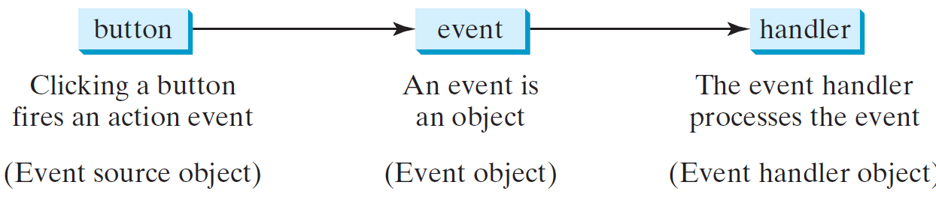
Handling GUI Events
Source object (e.g., button)
Listener object contains a method for processing the event.

Slide 8
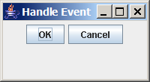
Trace Execution
animation
public class HandleEvent extends Application {
public void start(Stage primaryStage) {
…
OKHandlerClass handler1 = new OKHandlerClass();
btOK.setOnAction(handler1);
CancelHandlerClass handler2 = new CancelHandlerClass();
btCancel.setOnAction(handler2);
…
primaryStage.show(); // Display the stage
}
}
class OKHandlerClass implements EventHandler<ActionEvent> {
@Override
public void handle(ActionEvent e) {
System.out.println("OK button clicked");
}
}
1. Start from the main method to create a window and display it

Slide 9
Trace Execution
animation
public class HandleEvent extends Application {
public void start(Stage primaryStage) {
…
OKHandlerClass handler1 = new OKHandlerClass();
btOK.setOnAction(handler1);
CancelHandlerClass handler2 = new CancelHandlerClass();
btCancel.setOnAction(handler2);
…
primaryStage.show(); // Display the stage
}
}
class OKHandlerClass implements EventHandler<ActionEvent> {
@Override
public void handle(ActionEvent e) {
System.out.println("OK button clicked");
}
}
2. Click OK

Slide 10
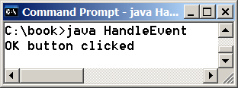
Trace Execution
animation
public class HandleEvent extends Application {
public void start(Stage primaryStage) {
…
OKHandlerClass handler1 = new OKHandlerClass();
btOK.setOnAction(handler1);
CancelHandlerClass handler2 = new CancelHandlerClass();
btCancel.setOnAction(handler2);
…
primaryStage.show(); // Display the stage
}
}
class OKHandlerClass implements EventHandler<ActionEvent> {
@Override
public void handle(ActionEvent e) {
System.out.println("OK button clicked");
}
}
3. Click OK. The JVM invokes the listener’s handle method

Slide 11
Events
An event can be defined as a type of signal to the program that something has happened.
The event is generated by external user actions such as mouse movements, mouse clicks, or keystrokes.

Slide 12
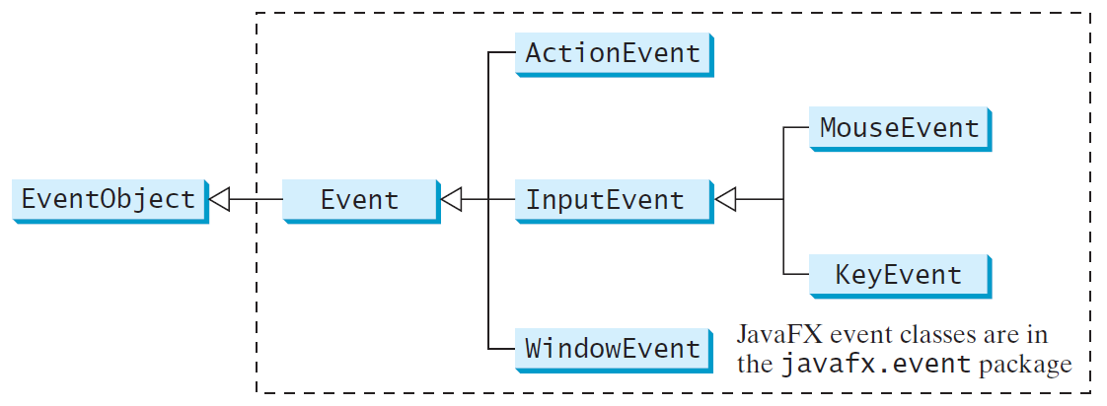
Event Classes

Slide 13
Event Information
An event object contains whatever properties are pertinent to the event. You can identify the source object of the event using the getSource() instance method in the EventObject class. The subclasses of EventObject deal with special types of events, such as button actions, window events, component events, mouse movements, and keystrokes. Table 16.1 lists external user actions, source objects, and event types generated.

Slide 14
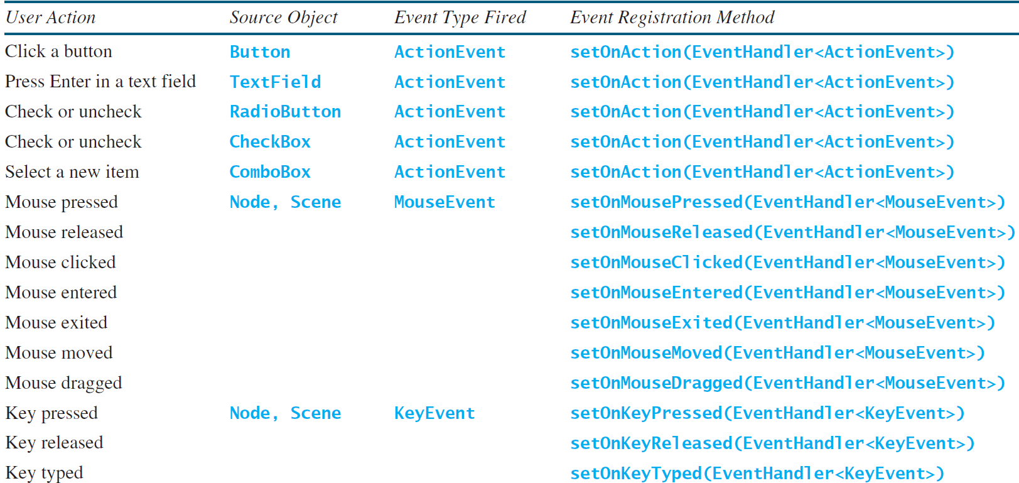
Selected User Actions and Handlers

Slide 15
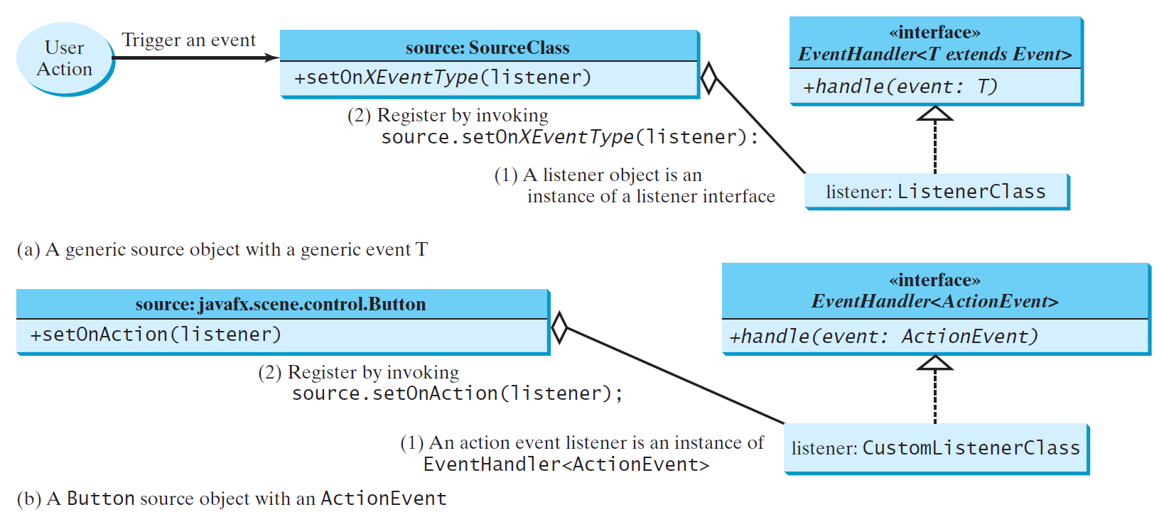
The Delegation Model

Slide 16
The Delegation Model: Example
Button btOK = new Button("OK");
OKHandlerClass handler = new OKHandlerClass();
btOK.setOnAction(handler);

Slide 17
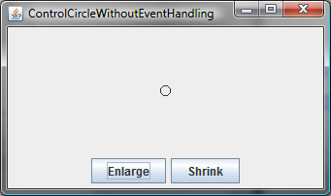
Example: First Version for ControlCircle (no listeners)
Now let us consider to write a program that uses two buttons to control the size of a circle.
ControlCircleWithoutEventHandling
Run

Slide 18
import javafx.application.Application;
import javafx.geometry.Pos;
import javafx.scene.Scene;
import javafx.scene.control.Button;
import javafx.scene.layout.StackPane;
import javafx.scene.layout.HBox;
import javafx.scene.layout.BorderPane;
import javafx.scene.paint.Color;
import javafx.scene.shape.Circle;
import javafx.stage.Stage;
public class ControlCircleWithoutEventHandling extends Application {
@Override // Override the start method in the Application class
public void start(Stage primaryStage) {
StackPane pane = new StackPane();
Circle circle = new Circle(50);
circle.setStroke(Color.BLACK);
circle.setFill(Color.WHITE);
pane.getChildren().add(circle);
HBox hBox = new HBox();
hBox.setSpacing(10);
hBox.setAlignment(Pos.CENTER);
Button btEnlarge = new Button("Enlarge");
Button btShrink = new Button("Shrink");
hBox.getChildren().add(btEnlarge);
hBox.getChildren().add(btShrink);
BorderPane borderPane = new BorderPane();
borderPane.setCenter(pane);
borderPane.setBottom(hBox);
BorderPane.setAlignment(hBox, Pos.CENTER);
// Create a scene and place it in the stage
Scene scene = new Scene(borderPane, 200, 150);
primaryStage.setTitle("ControlCircle"); // Set the stage title
primaryStage.setScene(scene); // Place the scene in the stage
primaryStage.show(); // Display the stage
}
/**
* The main method is only needed for the IDE with limited
* JavaFX support. Not needed for running from the command line.
*/
public static void main(String[] args) {
launch(args);
}
}

Slide 19
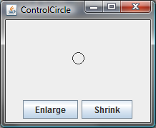
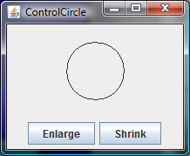
Example: Second Version for ControlCircle (with listener for Enlarge)
Now let us consider to write a program that uses two buttons to control the size of a circle.
ControlCircle
Run

Slide 20
import javafx.application.Application;
import javafx.event.ActionEvent;
import javafx.event.EventHandler;
import javafx.geometry.Pos;
import javafx.scene.Scene;
import javafx.scene.control.Button;
import javafx.scene.layout.StackPane;
import javafx.scene.layout.HBox;
import javafx.scene.layout.BorderPane;
import javafx.scene.paint.Color;
import javafx.scene.shape.Circle;
import javafx.stage.Stage;
public class ControlCircle extends Application {
private CirclePane circlePane = new CirclePane();
@Override // Override the start method in the Application class
public void start(Stage primaryStage) {
// Hold two buttons in an HBox
HBox hBox = new HBox();
hBox.setSpacing(10);
hBox.setAlignment(Pos.CENTER);
Button btEnlarge = new Button("Enlarge");
Button btShrink = new Button("Shrink");
hBox.getChildren().add(btEnlarge);
hBox.getChildren().add(btShrink);
// Create and register the handler
btEnlarge.setOnAction(new EnlargeHandler());
BorderPane borderPane = new BorderPane();
borderPane.setCenter(circlePane);
borderPane.setBottom(hBox);
BorderPane.setAlignment(hBox, Pos.CENTER);
// Create a scene and place it in the stage
Scene scene = new Scene(borderPane, 200, 150);
primaryStage.setTitle("ControlCircle"); // Set the stage title
primaryStage.setScene(scene); // Place the scene in the stage
primaryStage.show(); // Display the stage
}
class EnlargeHandler implements EventHandler<ActionEvent> {
@Override // Override the handle method
public void handle(ActionEvent e) {
circlePane.enlarge();
}
}
public static void main(String[] args) {
launch(args);
}
}
class CirclePane extends StackPane {
private Circle circle = new Circle(50);
public CirclePane() {
getChildren().add(circle);
circle.setStroke(Color.BLACK);
circle.setFill(Color.WHITE);
}
public void enlarge() {
circle.setRadius(circle.getRadius() + 2);
}
public void shrink() {
circle.setRadius(circle.getRadius() > 2 ?
circle.getRadius() - 2 : circle.getRadius());
}
}

Slide 21
Inner Class Listeners
A listener class is designed specifically to create a listener object for a GUI component (e.g., a button). It will not be shared by other applications. So, it is appropriate to define the listener class inside the frame class as an inner class.

Slide 22
Inner Classes
Inner class: A class is a member of another class.
Advantages: In some applications, you can use an inner class to make programs simple.
An inner class can reference the data and methods defined in the outer class in which it nests, so you do not need to pass the reference of the outer class to the constructor of the inner class.
ShowInnerClass

Slide 23
// ShowInnerClass.java: Demonstrate using inner classes
public class ShowInnerClass {
private int data;
/** A method in the outer class */
public void m() {
// Do something
InnerClass instance = new InnerClass();
}
// An inner class
class InnerClass {
/** A method in the inner class */
public void mi() {
// Directly reference data and method defined in its outer class
data++;
m();
}
}
}

Slide 24
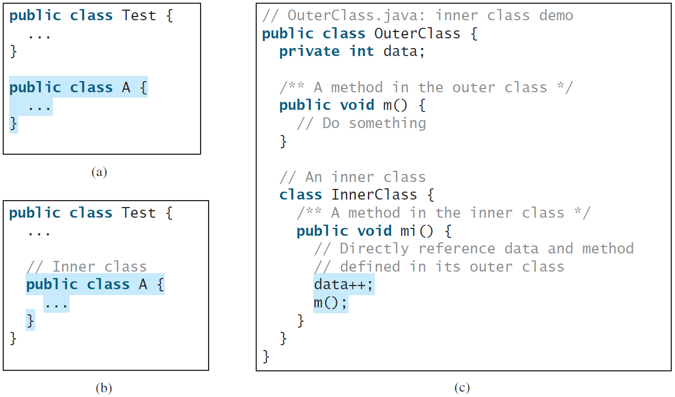
Inner Classes, cont.

Slide 25
Inner Classes (cont.)
Inner classes can make programs simple and concise.
An inner class supports the work of its containing outer class and is compiled into a class named OuterClassName$InnerClassName.class. For example, the inner class InnerClass in OuterClass is compiled into OuterClass$InnerClass.class.

Slide 26
Inner Classes (cont.)
An inner class can be declared public, protected, or private subject to the same visibility rules applied to a member of the class.
An inner class can be declared static. A static inner class can be accessed using the outer class name. A static inner class cannot access nonstatic members of the outer class

Slide 27
Anonymous Inner Classes
An anonymous inner class must always extend a superclass or implement an interface, but it cannot have an explicit extends or implements clause.
An anonymous inner class must implement all the abstract methods in the superclass or in the interface.
An anonymous inner class always uses the no-arg constructor from its superclass to create an instance. If an anonymous inner class implements an interface, the constructor is Object().
An anonymous inner class is compiled into a class named OuterClassName$n.class. For example, if the outer class Test has two anonymous inner classes, these two classes are compiled into Test$1.class and Test$2.class.

Slide 28
Anonymous Inner Classes (cont.)
Inner class listeners can be shortened using anonymous inner classes. An anonymous inner class is an inner class without a name. It combines declaring an inner class and creating an instance of the class in one step. An anonymous inner class is declared as follows:
new SuperClassName/InterfaceName() {
// Implement or override methods in superclass or interface
// Other methods if necessary
}

Slide 29
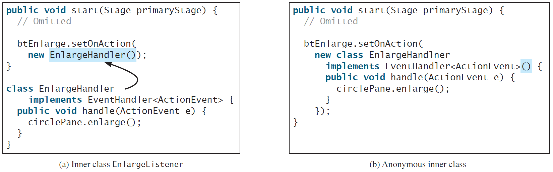
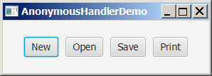
Anonymous Inner Classes (cont.)
AnonymousHandlerDemo
Run

Slide 30

import javafx.application.Application;
import javafx.event.ActionEvent;
import javafx.event.EventHandler;
import javafx.geometry.Pos;
import javafx.scene.Scene;
import javafx.scene.control.Button;
import javafx.scene.layout.HBox;
import javafx.stage.Stage;
public class AnonymousHandlerDemo extends Application {
@Override // Override the start method in the Application class
public void start(Stage primaryStage) {
// Hold two buttons in an HBox
HBox hBox = new HBox();
hBox.setSpacing(10);
hBox.setAlignment(Pos.CENTER);
Button btNew = new Button("New");
Button btOpen = new Button("Open");
Button btSave = new Button("Save");
Button btPrint = new Button("Print");
hBox.getChildren().addAll(btNew, btOpen, btSave, btPrint);
// Create and register the handler
btNew.setOnAction(new EventHandler<ActionEvent>() {
@Override // Override the handle method
public void handle(ActionEvent e) {
System.out.println("Process New");
}
});
btOpen.setOnAction(new EventHandler<ActionEvent>() {
@Override // Override the handle method
public void handle(ActionEvent e) {
System.out.println("Process Open");
}
});
btSave.setOnAction(new EventHandler<ActionEvent>() {
@Override // Override the handle method
public void handle(ActionEvent e) {
System.out.println("Process Save");
}
});
btPrint.setOnAction(new EventHandler<ActionEvent>() {
@Override // Override the handle method
public void handle(ActionEvent e) {
System.out.println("Process Print");
}
});
// Create a scene and place it in the stage
Scene scene = new Scene(hBox, 300, 50);
primaryStage.setTitle("AnonymousHandlerDemo"); // Set title
primaryStage.setScene(scene); // Place the scene in the stage
primaryStage.show(); // Display the stage
}
/**
* The main method is only needed for the IDE with limited
* JavaFX support. Not needed for running from the command line.
*/
public static void main(String[] args) {
launch(args);
}
}

Slide 31
Simplifying Event Handing Using Lambda Expressions
Lambda expression is a new feature in Java 8. Lambda expressions can be viewed as an anonymous method with a concise syntax. For example, the following code in (a) can be greatly simplified using a lambda expression in (b) in three lines.

Slide 32
Basic Syntax for a Lambda Expression
The basic syntax for a lambda expression is either
(type1 param1, type2 param2, ...) -> expression
or
(type1 param1, type2 param2, ...) -> { statements; }
The data type for a parameter may be explicitly declared or implicitly inferred by the compiler. The parentheses can be omitted if there is only one parameter without an explicit data type.

Slide 33
Single Abstract Method Interface (SAM)
The statements in the lambda expression is all for that method. If it contains multiple methods, the compiler will not be able to compile the lambda expression. So, for the compiler to understand lambda expressions, the interface must contain exactly one abstract method. Such an interface is known as a functional interface, or a Single Abstract Method (SAM) interface.
LambdaHandlerDemo
Run

Slide 34

import javafx.application.Application;
import javafx.event.ActionEvent;
import javafx.geometry.Pos;
import javafx.scene.Scene;
import javafx.scene.control.Button;
import javafx.scene.layout.HBox;
import javafx.stage.Stage;
public class LambdaHandlerDemo extends Application {
@Override // Override the start method in the Application class
public void start(Stage primaryStage) {
// Hold two buttons in an HBox
HBox hBox = new HBox();
hBox.setSpacing(10);
hBox.setAlignment(Pos.CENTER);
Button btNew = new Button("New");
Button btOpen = new Button("Open");
Button btSave = new Button("Save");
Button btPrint = new Button("Print");
hBox.getChildren().addAll(btNew, btOpen, btSave, btPrint);
// Create and register the handler
btNew.setOnAction((ActionEvent e) -> {
System.out.println("Process New");
});
btOpen.setOnAction((e) -> {
System.out.println("Process Open");
});
btSave.setOnAction(e -> {
System.out.println("Process Save");
});
btPrint.setOnAction(e -> System.out.println("Process Print"));
// Create a scene and place it in the stage
Scene scene = new Scene(hBox, 300, 50);
primaryStage.setTitle("LambdaHandlerDemo"); // Set title
primaryStage.setScene(scene); // Place the scene in the stage
primaryStage.show(); // Display the stage
}
/**
* The main method is only needed for the IDE with limited
* JavaFX support. Not needed for running from the command line.
*/
public static void main(String[] args) {
launch(args);
}
}

Slide 35
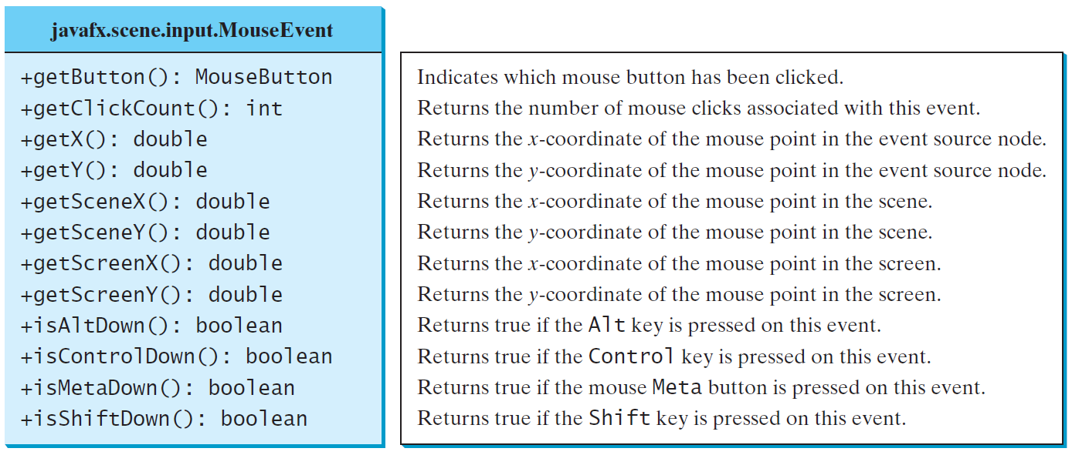
The MouseEvent Class
MouseEventDemo
Run

Slide 36
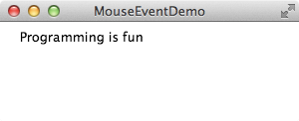
import javafx.application.Application;
import javafx.scene.Scene;
import javafx.scene.layout.Pane;
import javafx.scene.text.Text;
import javafx.stage.Stage;
public class MouseEventDemo extends Application {
@Override // Override the start method in the Application class
public void start(Stage primaryStage) {
// Create a pane and set its properties
Pane pane = new Pane();
Text text = new Text(20, 20, "Programming is fun");
pane.getChildren().addAll(text);
text.setOnMouseDragged(e -> {
text.setX(e.getX());
text.setY(e.getY());
});
// Create a scene and place it in the stage
Scene scene = new Scene(pane, 300, 100);
primaryStage.setTitle("MouseEventDemo"); // Set the stage title
primaryStage.setScene(scene); // Place the scene in the stage
primaryStage.show(); // Display the stage
}
/**
* The main method is only needed for the IDE with limited
* JavaFX support. Not needed for running from the command line.
*/
public static void main(String[] args) {
launch(args);
}
}

Slide 37
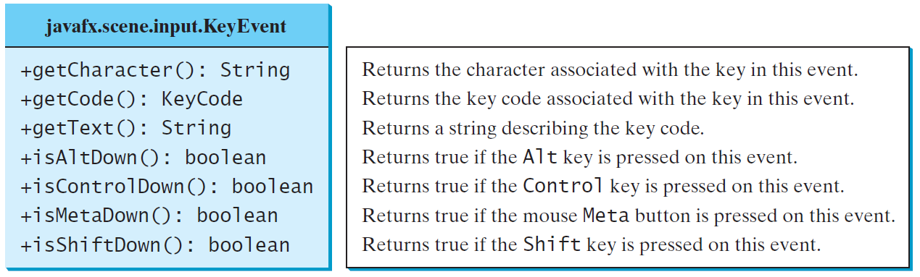
The KeyEvent Class
KeyEventDemo
Run

Slide 38
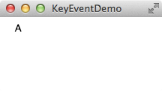
import javafx.application.Application;
import javafx.scene.Scene;
import javafx.scene.layout.Pane;
import javafx.scene.text.Text;
import javafx.stage.Stage;
public class KeyEventDemo extends Application {
@Override // Override the start method in the Application class
public void start(Stage primaryStage) {
// Create a pane and set its properties
Pane pane = new Pane();
Text text = new Text(20, 20, "A");
pane.getChildren().add(text);
text.setOnKeyPressed(e -> {
switch (e.getCode()) {
case DOWN: text.setY(text.getY() + 10); break;
case UP: text.setY(text.getY() - 10); break;
case LEFT: text.setX(text.getX() - 10); break;
case RIGHT: text.setX(text.getX() + 10); break;
default:
if (Character.isLetterOrDigit(e.getText().charAt(0)))
text.setText(e.getText());
}
});
// Create a scene and place the pane in the stage
Scene scene = new Scene(pane);
primaryStage.setTitle("KeyEventDemo"); // Set the stage title
primaryStage.setScene(scene); // Place the scene in the stage
primaryStage.show(); // Display the stage
text.requestFocus(); // text is focused to receive key input
}
/**
* The main method is only needed for the IDE with limited
* JavaFX support. Not needed for running from the command line.
*/
public static void main(String[] args) {
launch(args);
}
}

Slide 39
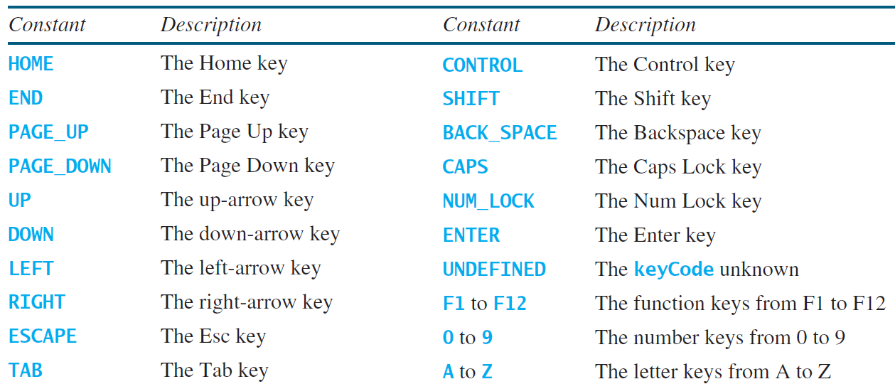
The KeyCode Constants

Slide 40
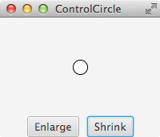
Example: Control Circle with Mouse and Key
ControlCircleWithMouseAndKey
Run

Slide 41
import javafx.application.Application;
import javafx.geometry.Pos;
import javafx.scene.Scene;
import javafx.scene.control.Button;
import javafx.scene.input.KeyCode;
import javafx.scene.input.MouseButton;
import javafx.scene.layout.HBox;
import javafx.scene.layout.BorderPane;
import javafx.stage.Stage;
public class ControlCircleWithMouseAndKey extends Application {
private CirclePane circlePane = new CirclePane();
@Override // Override the start method in the Application class
public void start(Stage primaryStage) {
// Hold two buttons in an HBox
HBox hBox = new HBox();
hBox.setSpacing(10);
hBox.setAlignment(Pos.CENTER);
Button btEnlarge = new Button("Enlarge");
Button btShrink = new Button("Shrink");
hBox.getChildren().add(btEnlarge);
hBox.getChildren().add(btShrink);
// Create and register the handler
btEnlarge.setOnAction(e -> circlePane.enlarge());
btShrink.setOnAction(e -> circlePane.shrink());
circlePane.setOnMouseClicked(e -> {
if (e.getButton() == MouseButton.PRIMARY) {
circlePane.enlarge();
}
else if (e.getButton() == MouseButton.SECONDARY) {
circlePane.shrink();
}
});
circlePane.setOnKeyPressed(e -> {
if (e.getCode() == KeyCode.U) {
circlePane.enlarge();
}
else if (e.getCode() == KeyCode.D) {
circlePane.shrink();
}
});
BorderPane borderPane = new BorderPane();
borderPane.setCenter(circlePane);
borderPane.setBottom(hBox);
BorderPane.setAlignment(hBox, Pos.CENTER);
// Create a scene and place it in the stage
Scene scene = new Scene(borderPane, 200, 150);
primaryStage.setTitle("ControlCircle"); // Set the stage title
primaryStage.setScene(scene); // Place the scene in the stage
primaryStage.show(); // Display the stage
circlePane.requestFocus();
}
/**
* The main method is only needed for the IDE with limited
* JavaFX support. Not needed for running from the command line.
*/
public static void main(String[] args) {
launch(args);
}
}

Slide 42
Summary
Event-driven programming – ActionEvent, …
Esp. the LoanCalculator of slide #2.

Slide 43
End of Chapter 2

